Slide 1
Home security USING INTERNET OF THINGS
Presented by,
Joyal raju
c0749019

Slide 2
content
INTRODUCTION
LITERATURE REVIEW
BLOCK DIAGRAM AND COMPONENTS
WORKING PRINCIPLE
ADVANTAGES AND DISADVANTAGES
CONCLUSION
REFERANCES

Slide 3
INTRODUCTION
Security is a major concern nowadays.
Wireless technologies is introduced as a part of security systems.
Arduino is an open source platform to run as central processing unit for this system.
IoT helps to communicate and exchange data among system without the need of any humans.
This system can be implemented in areas reserved for authorized personnel.

Slide 4
Literature review
Home security based on GSM technology was introduced 2014, which send user a mail and trigger alarm when camera detect motion.
Laser ray and LDR sensor used intrusion detection system was introduced in 2016, but user notification system were not mentioned in it .

Slide 5
Block diagram and components
COMPONENTS
Arduino UNO : Works as the controller/processor for the system.
WIFI Module : ESP8266 module will send the data to blynk server.
Reed sensor module : Produce output when there is a variation in magnetic field.
Alarm buzzer :Produce alarm sound when there is an unauthorized access occur.
Blynk app : Helps to provide notification to user.

Slide 6
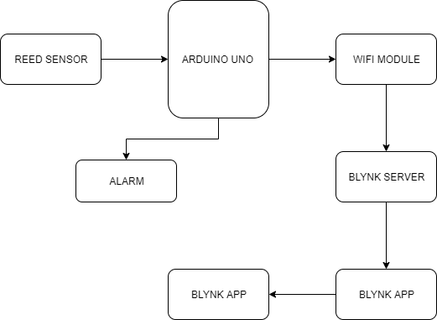
Block diagram and components (conTD…)
BLOCK DIAGRAM

Slide 7
WORKING PRINCIPLE
Reed sensor module produce low level output when door is open.
Alarm buzzer will be activated when there is an unauthorized access occur
Arduino microcontroller will process the output from reed sensor according to written code and pass the data to WIFI module.
WIFI module upload the data to blynk server with specific authentication ID.
Blynk server provide notifications to blynk app.
Blynk app popup notification on user’s phone

Slide 8
Advantages and disadvantages
Advantages
Ease of setting up
Low cost
Low maintenance
Easily upgradable
Alarm control from user phone
Disadvantages
Server initialization is hard

Slide 9
conclusion
Sensor placed on door provide necessary information to user as soon as the door is open through a push notification even if phone is locked.
Installation in commercial offices informs administrator about unauthorized access to restricted areas.
Use of blynk application provide notification as well as alarm control in user smartphone.

Slide 10
references
Home security system using internet of things (2017)
https://iopscience.iop.org/article/10.1088/1757-899X/263/4/042026
Multilevel home security system using Arduino and GSM (December 2018)
https://www.researchgate.net/publication/329558717_Multilevel_Home_Security_System_using_Arduino_GSM
https://www.reed-sensor.com/general/product_catalogs/

Slide 11
Thank you all….!

